Slide 1
IMAGE GENERATION FROM TEXT PROMPT USING CLIP & TRANSFORMER
Subrat Ku Nanda

Slide 2
Text-to-image generation (TTI)
It refers to the usage of models that could process text input and generate high fidelity images based on text descriptions
The development of TTI models has been influenced by the Generative Adversarial Network (GAN) and autoregressive Transformer.
In foundation -> NLP and computer vision models to AIGC (AI Generated Content) AIGC is capable of producing high-quality content generated by human writers, designers, and artists.
Ex: LLM (language generation models) like ChatGPT demonstrate a remarkable ability to understand complex language and respond with expertly crafted text, closely aligned with the input query.

Slide 3
Continue..
- VQGAN and CLIP are actually two separate machine learning algorithms that can be used together to generate images based on a text prompt.
- VQGAN is a generative adversarial neural network that is good at generating images that look similar to others (but not from a prompt)
- CLIP is another neural network that is able to determine how well a caption (or prompt) matches an image.
AIM of the experiment/Project
comparison and critique of different TTI methods and suggests pathways for future improvement

Slide 4
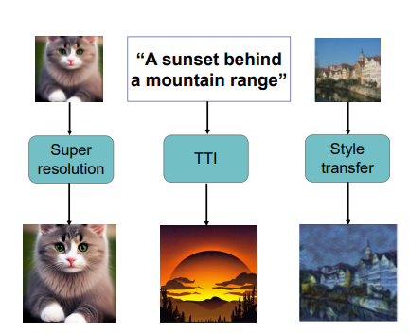
AI Image generation
Super-resolution enhances the image by adding more details and generates the output with high fidelity.
Style change transfers the image to another domain with mutual information.
Text-to-image generates high quality images that are well aligned with user input.

Slide 5

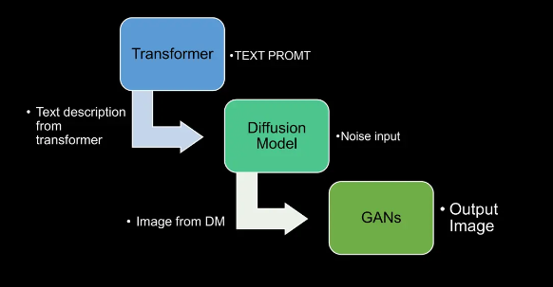

Slide 6
Contrastive Language-Image Pre-training (CLIP)
CLIP (Contrastive Language-Image Pre-Training) is a neural network trained on a variety of (image, text) pairs.
CLIP builds on a large body of work on zero-shot transfer, natural language supervision, and multimodal learning.
It can be instructed in natural language to predict the most relevant text snippet, given an image, without directly optimizing for the task, similarly to the zero-shot capabilities of GPT-2 and 3.
CLIP matches the performance of the original ResNet50 on ImageNet “zero-shot” without using any of the original 1.28M labeled examples, overcoming several major challenges in computer vision.

Slide 7
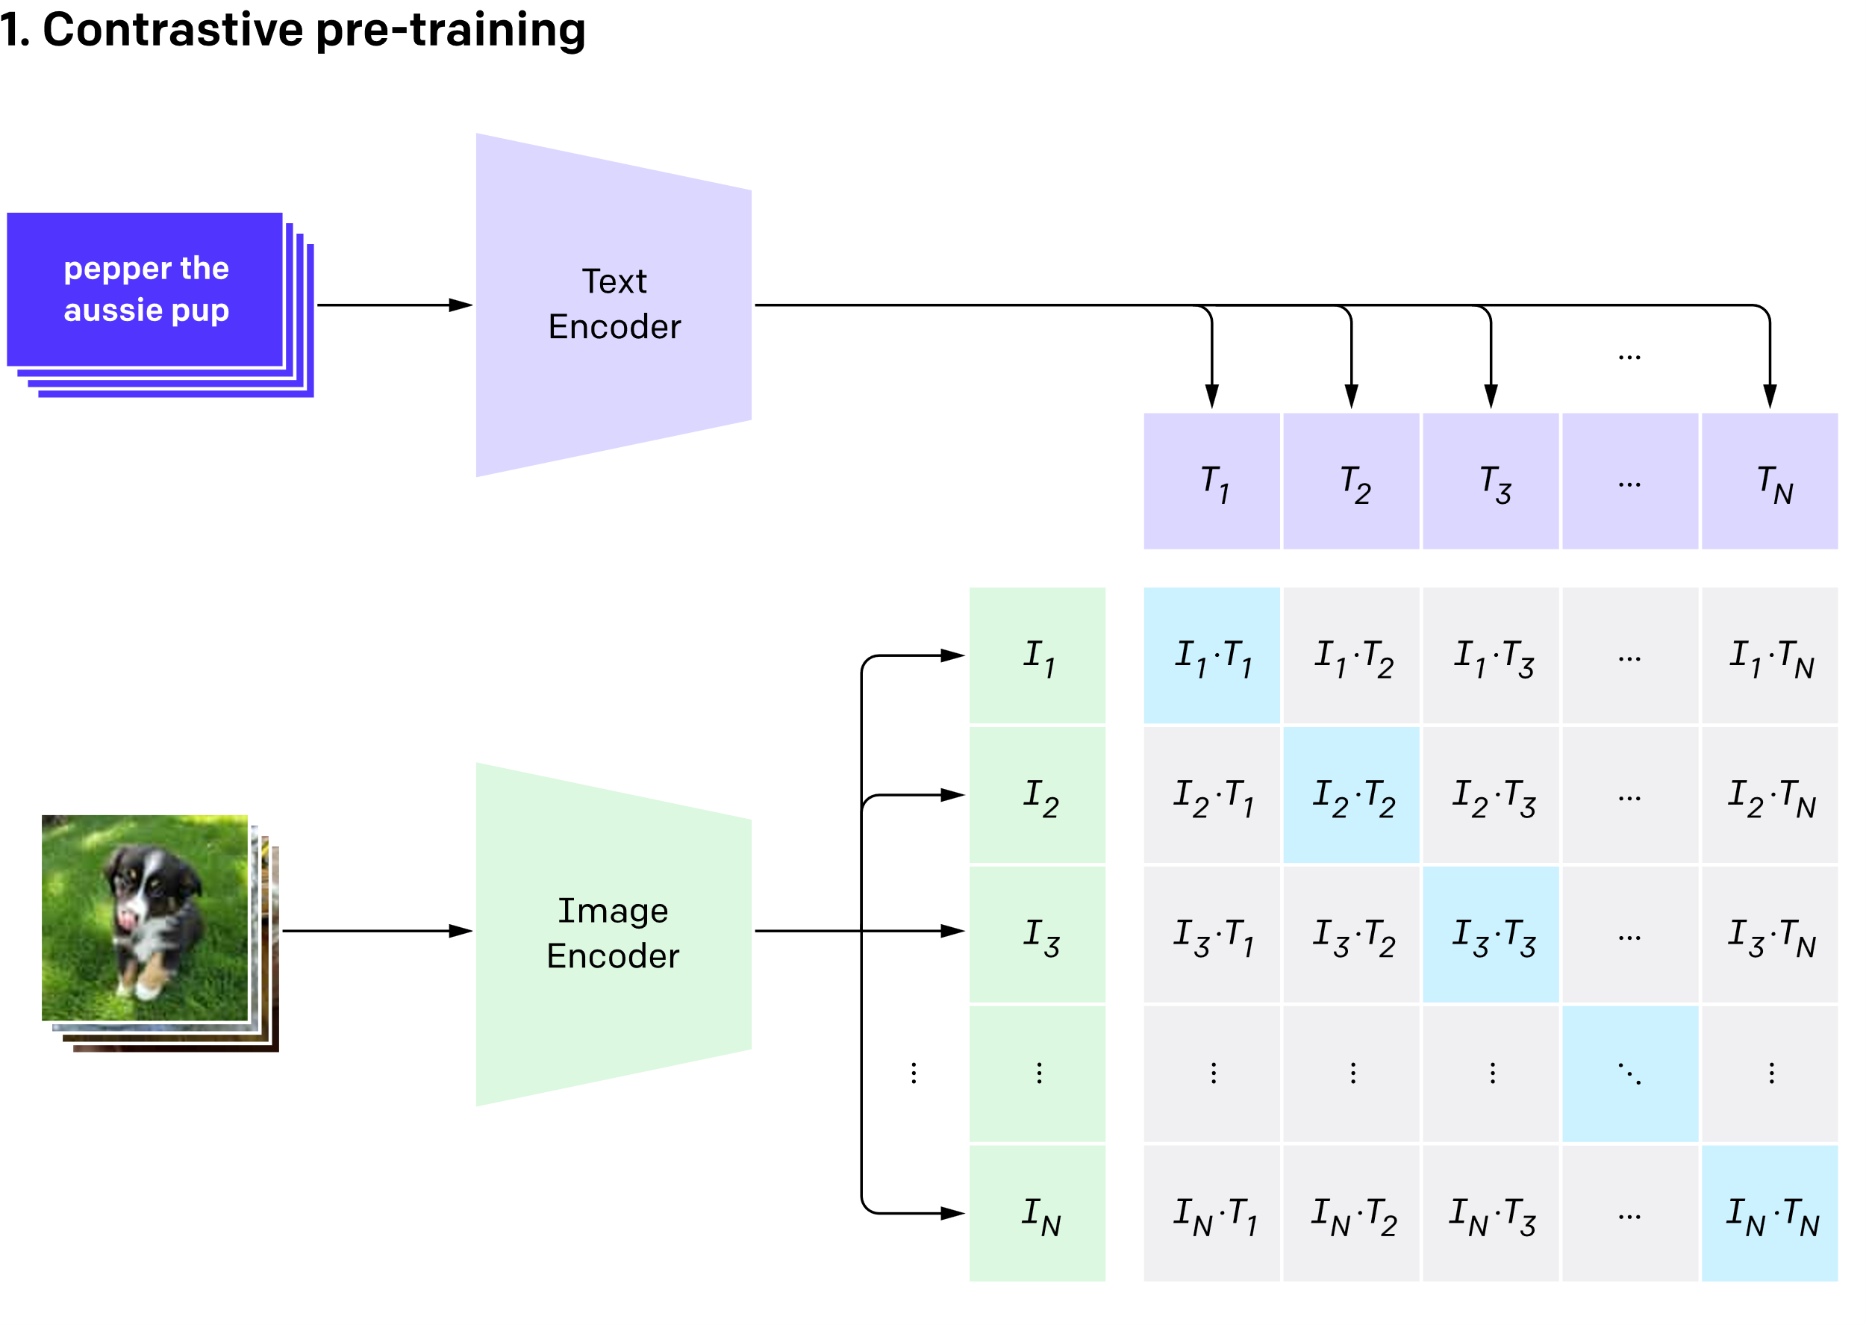
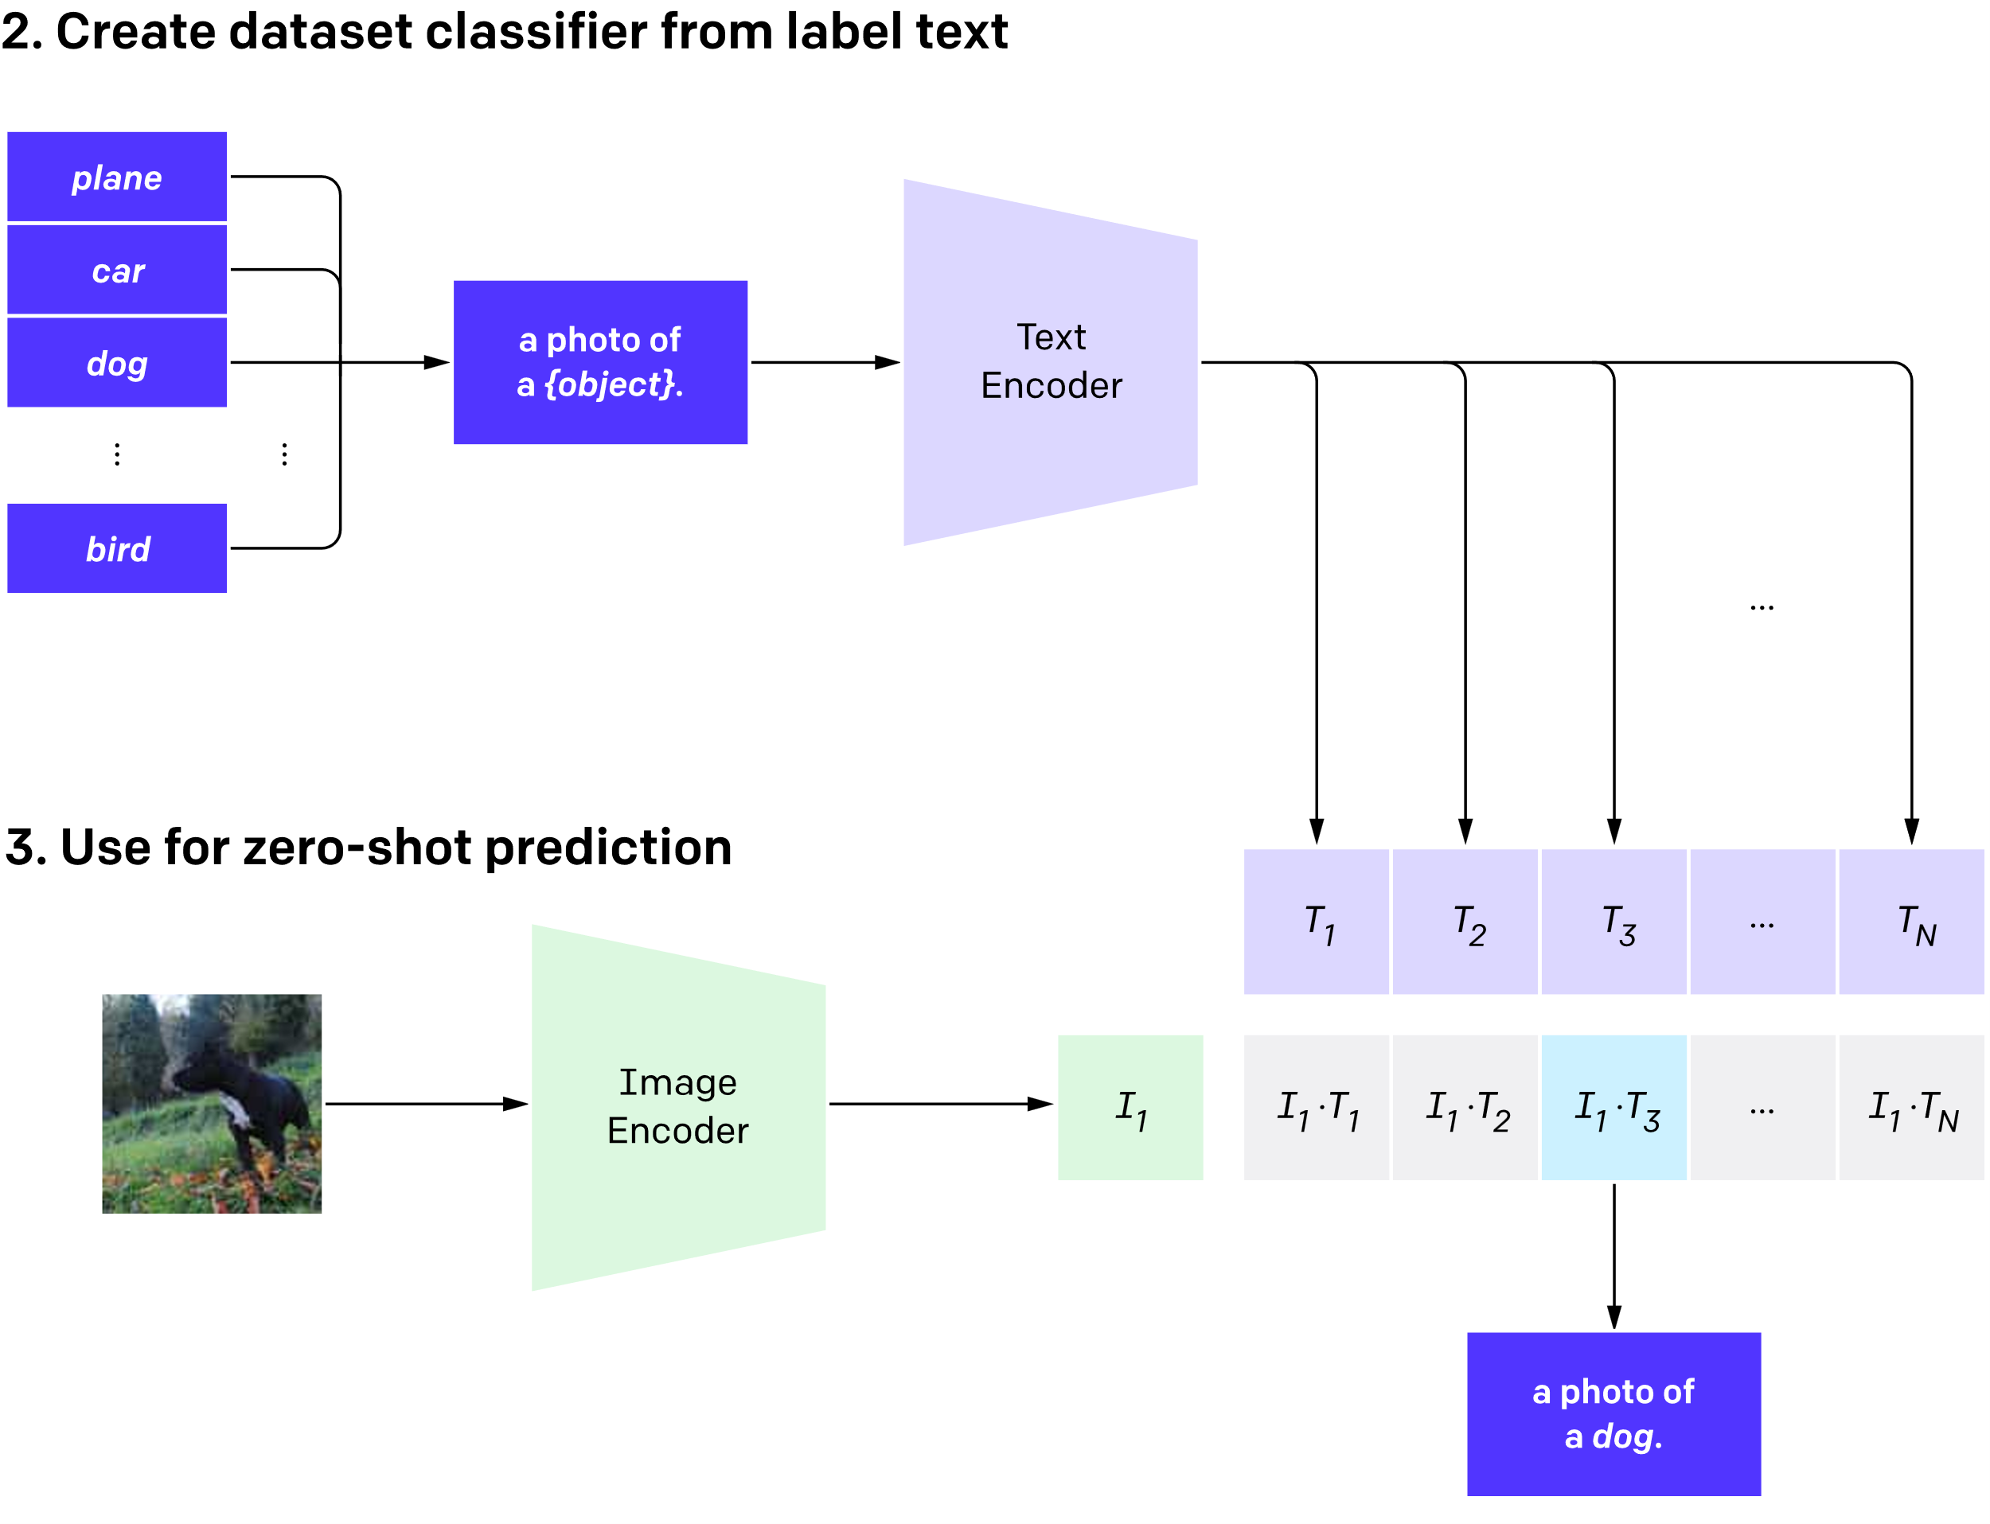
CLIP is trained over WebImage Text(WIT) 400M image-text pair. Diverse dataset crawled from internet.

Slide 8
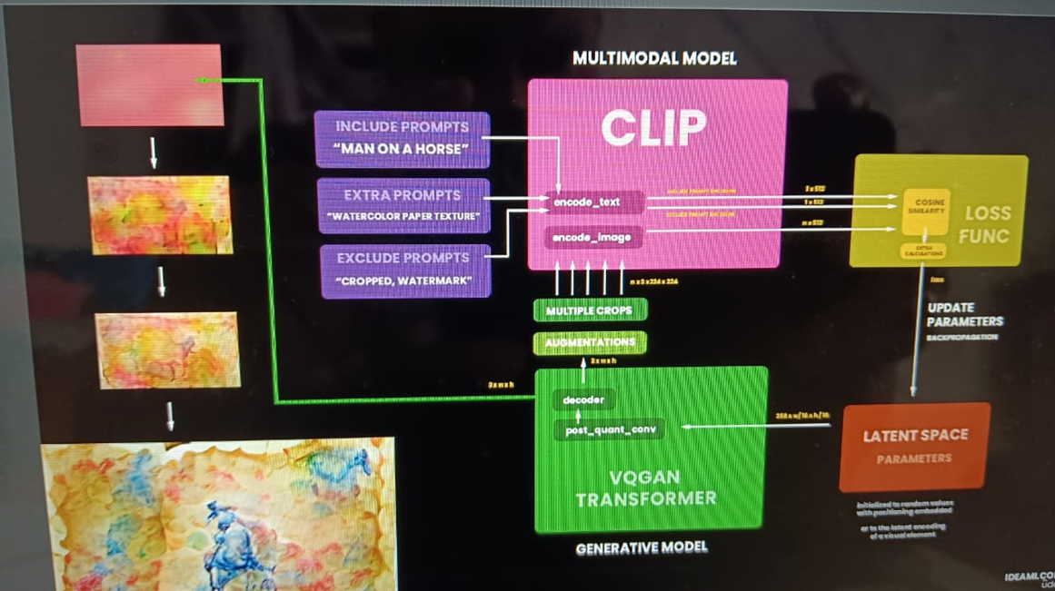

Slide 9
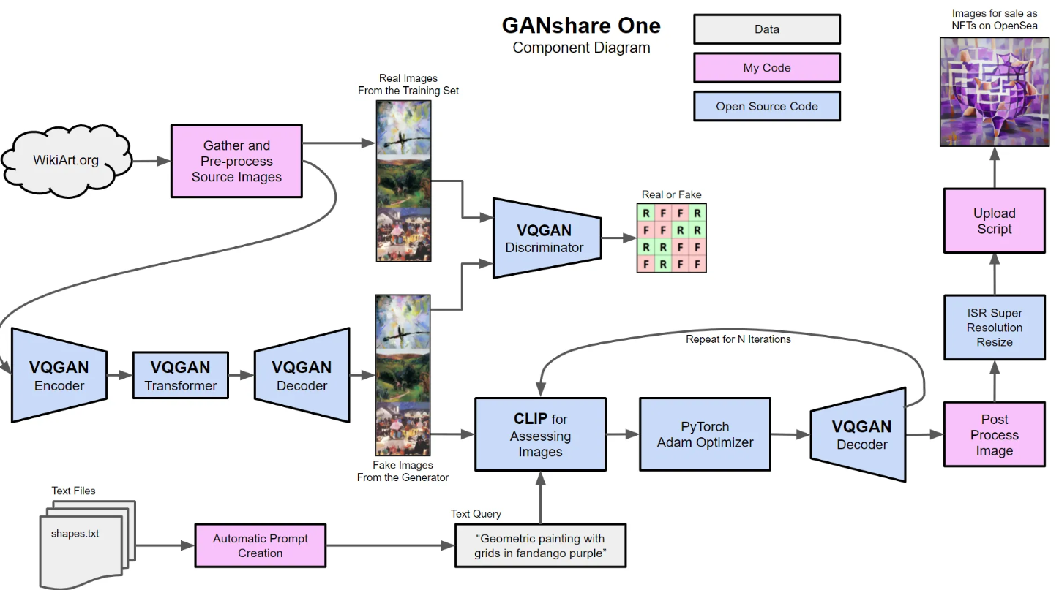

Slide 10
Application of CLIP
Few Applications which could be build with CLIP are -
Zero Shot Image classification
Fine Tuned Image Classification
Semantic Image Retrieval
Content Moderation
Image Ranking
Image Captioning
Deciphering Blurred Images

Slide 11
Thank You

